Slide 1
CI453
Ben Highgate, Ahmed El-Hawat, Minas Fakhori, Michael Ugwumba,

Slide 2
Agenda
Project management
The Website and the features
Group Communication
Legal & ethical considerations

Slide 3
The Website
Subtitle

Slide 4
Project Management
Research
· Brainstorming
·Target audience research
· Designing of the website
1
Planning
· To do list and delegation of tasks. (Trello)
· Time management. (Gantt chart)
2
Development
· HTML
· CSS
· JS
3
Combining and testing the websites
· Github
· HTML validation
· CSS validation
· Black box test
4

Slide 5
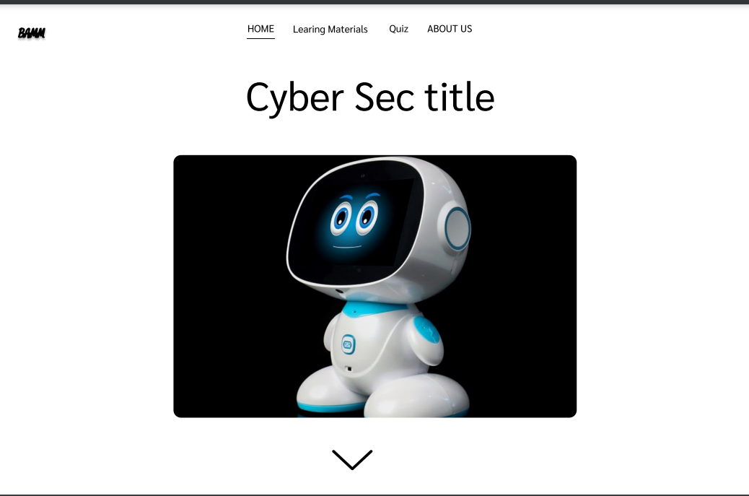
Research
1
Research
· Target audience research
· Brainstorming
· Designing of the website

Slide 6
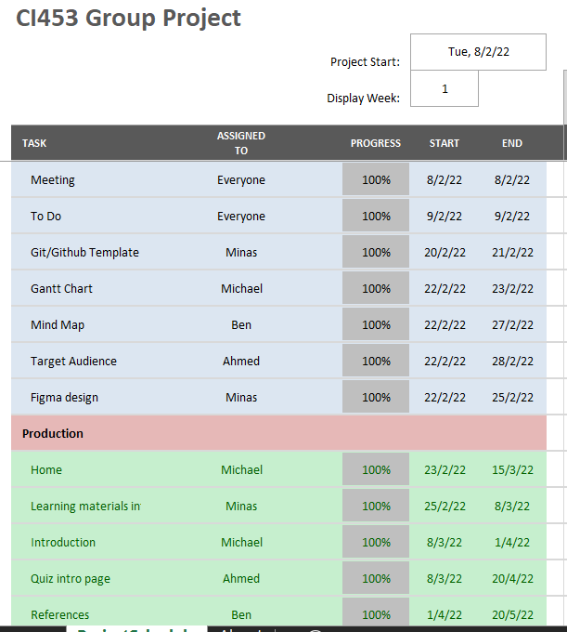
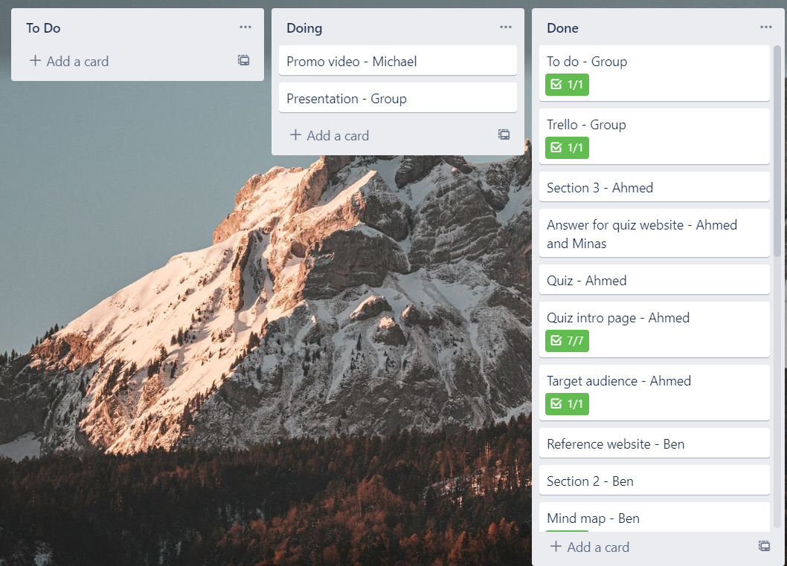
Planning
2
Planning
· To do list and delegation of tasks. (Trello)
· Time management. (Gantt chart)

Slide 7
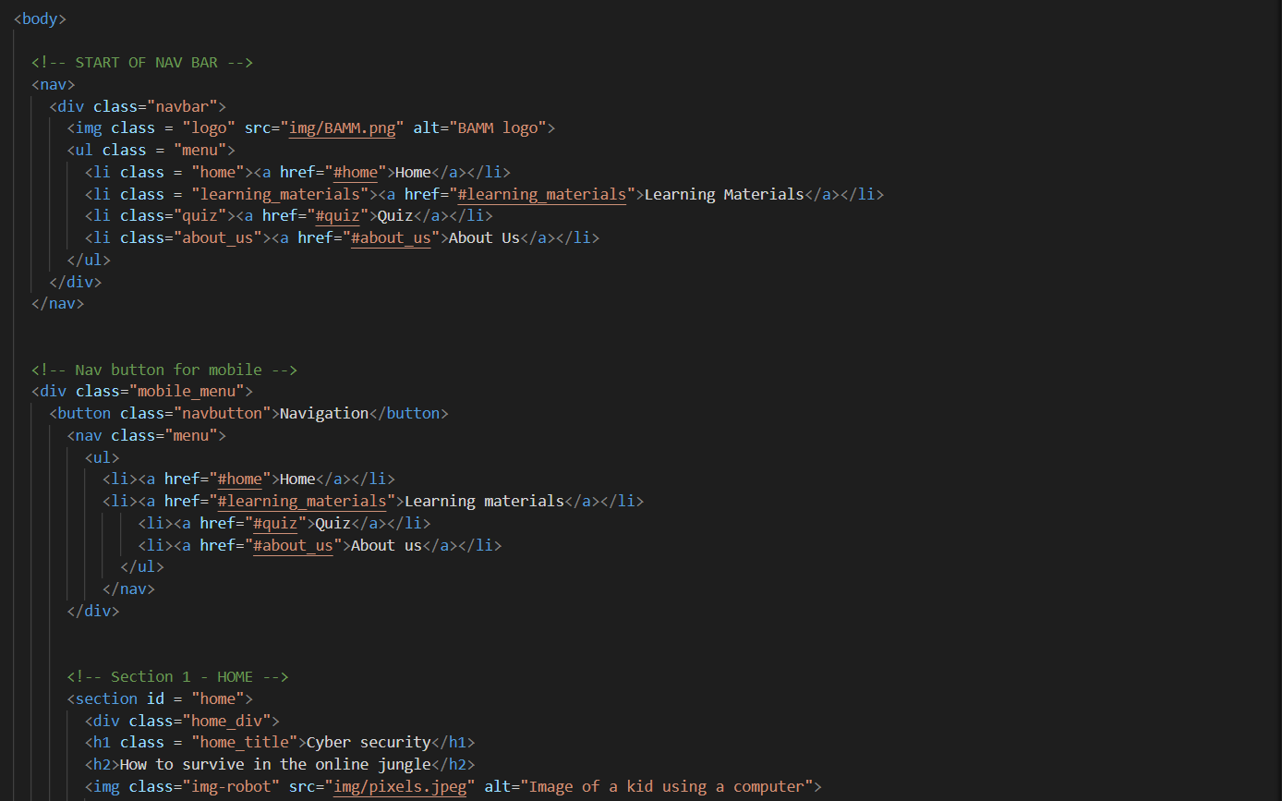
Development
3
Development
· HTML
· CSS
· JS

Slide 8
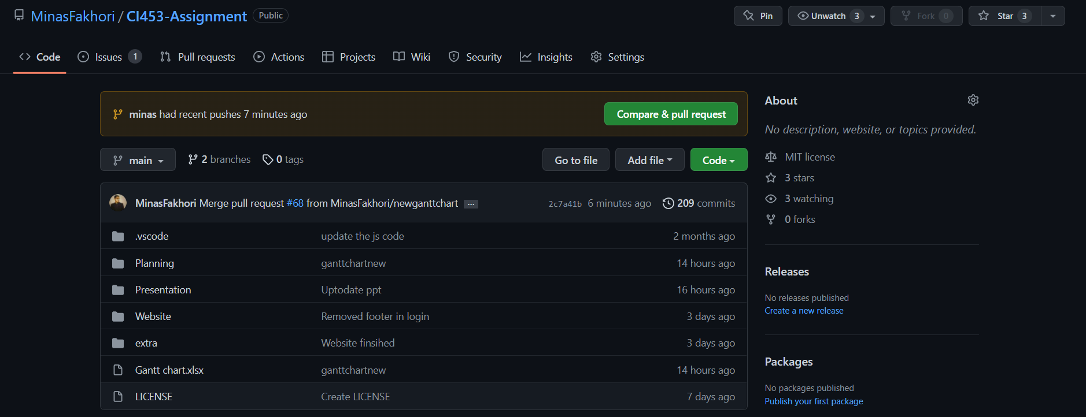
Combining and testing the websites
4
Combining and testing the websites
· Github
· HTML validation
· CSS validation
· Black box test

Slide 9
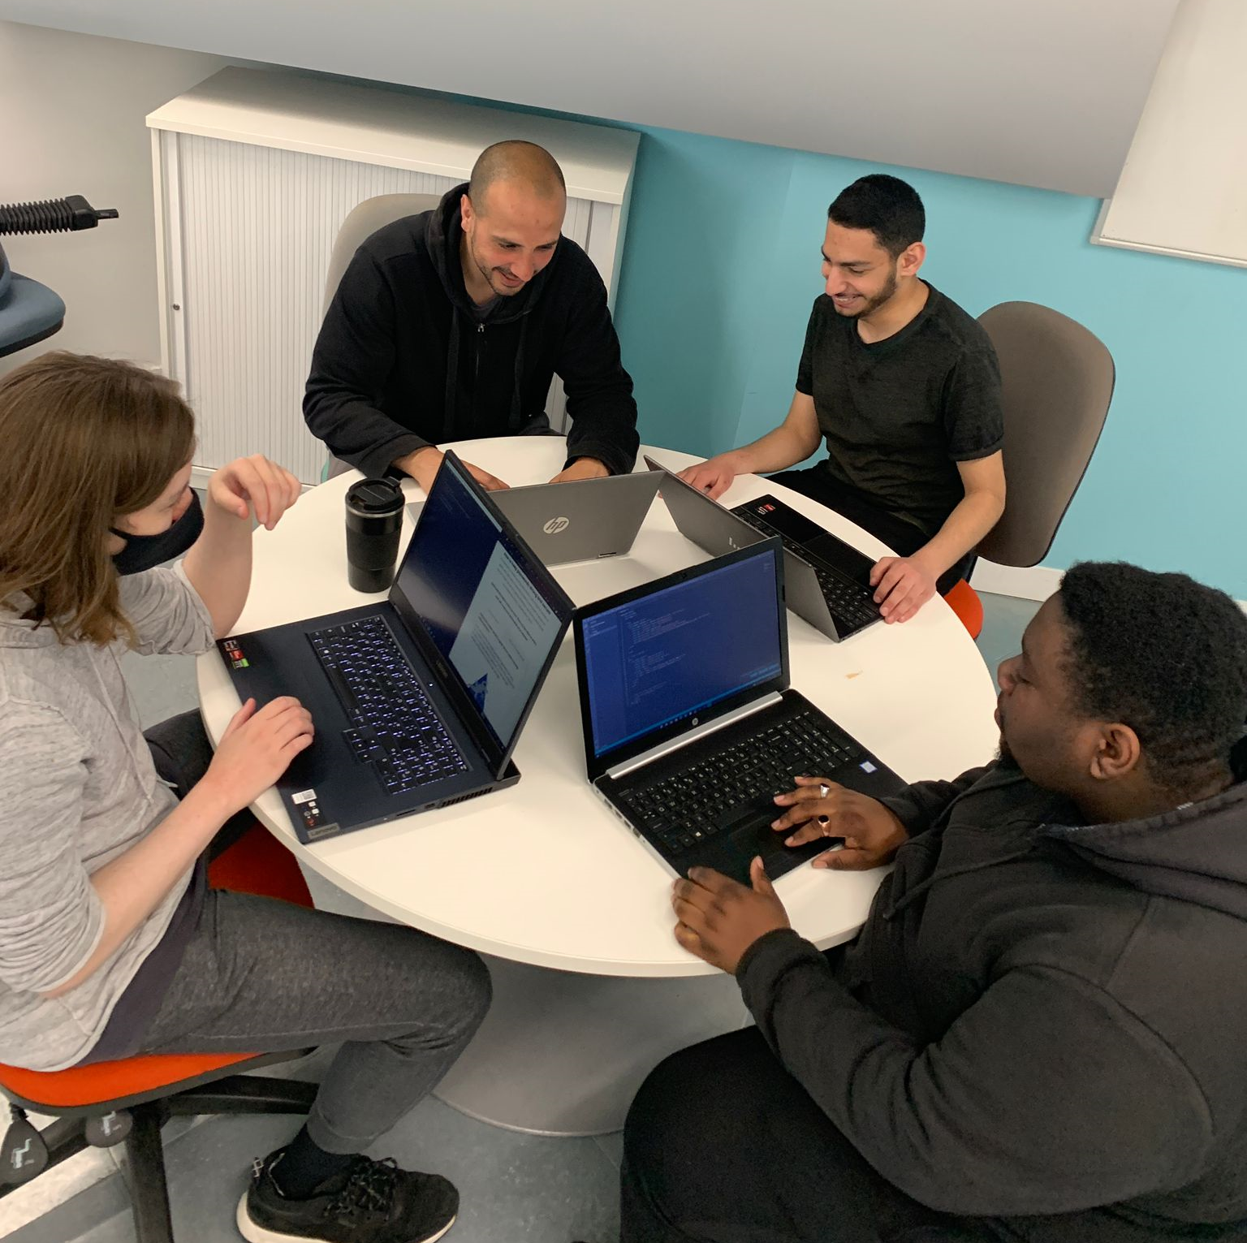
Working as a team and Group communication

Slide 10
Our website
Features
Interactive quiz
Navigation
Page previews
Accessibility features
***The contact page (best)
Responsive

Slide 11
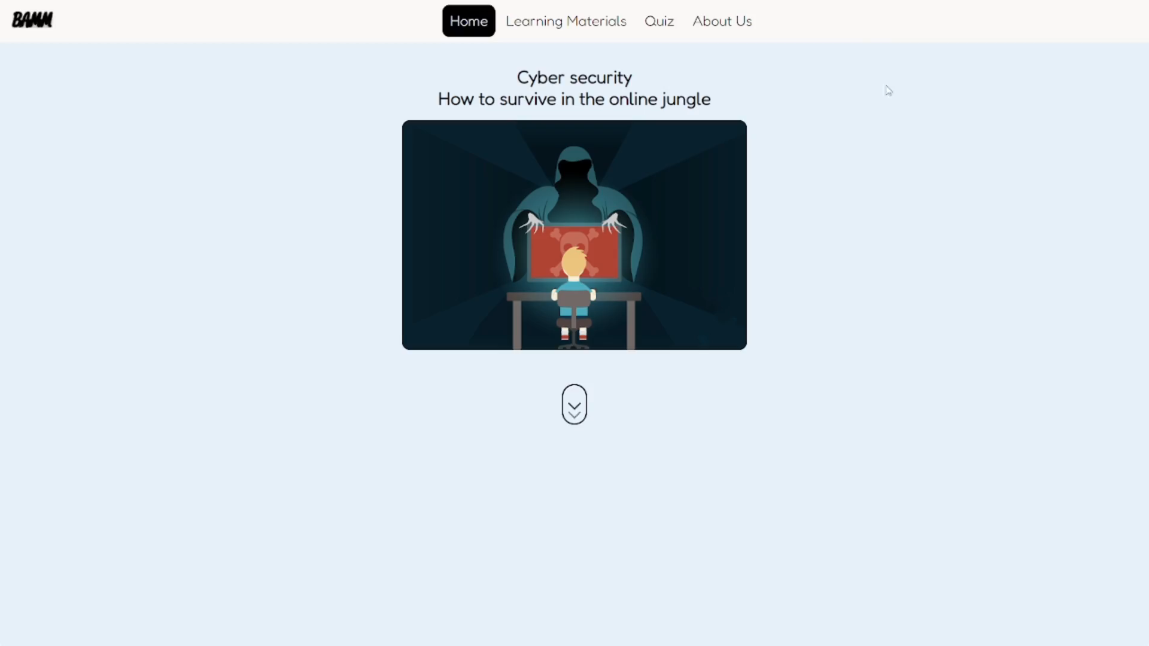
Navigation bar

Slide 12
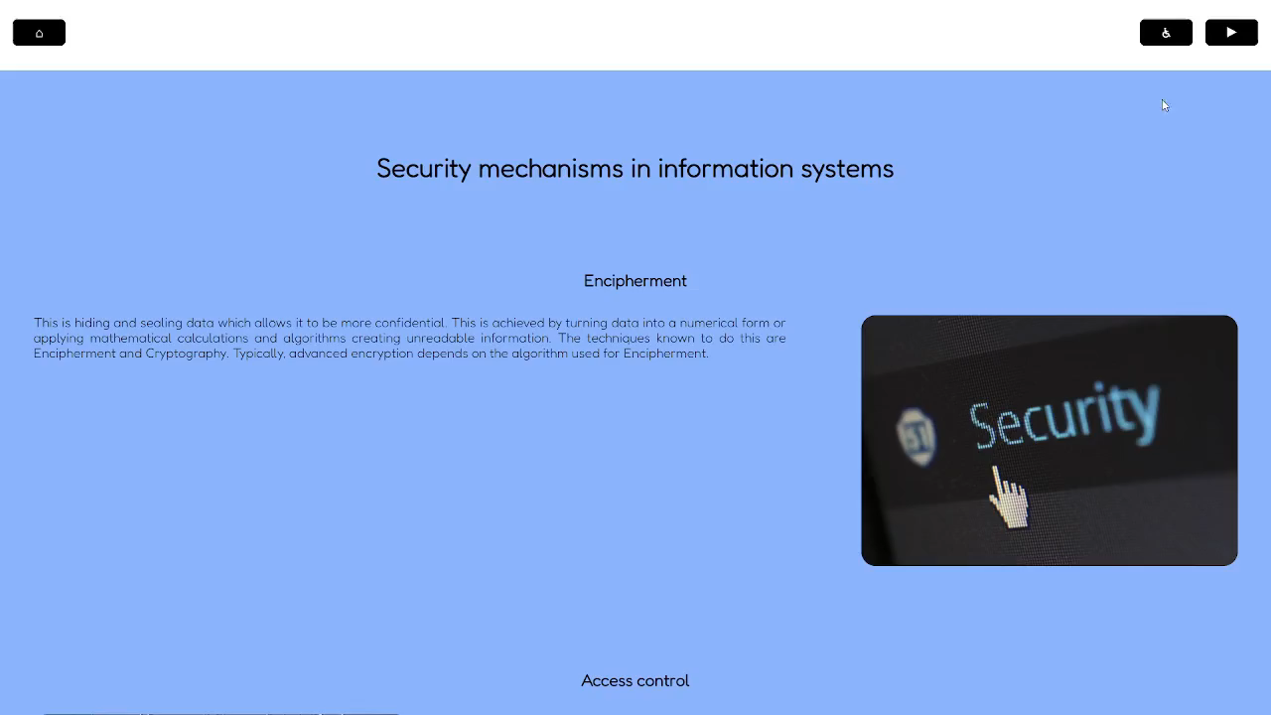

Accessibly button

Slide 13
Responsive

Slide 14
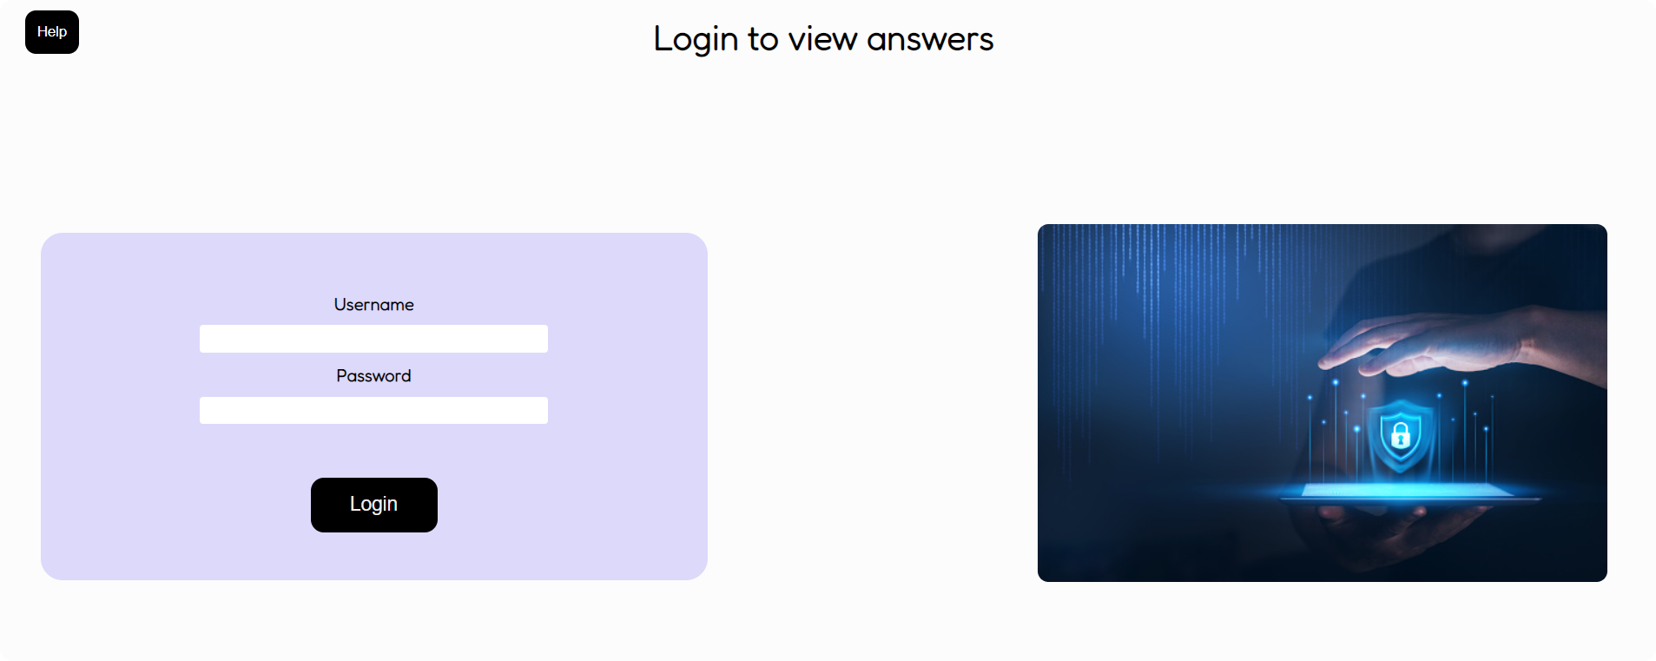
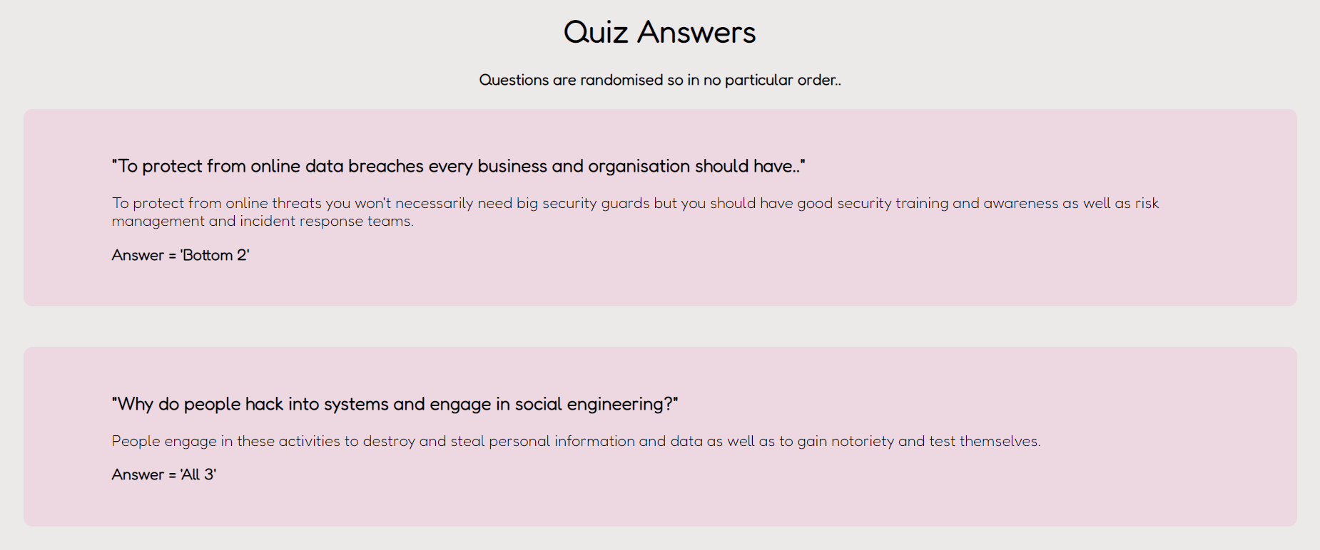
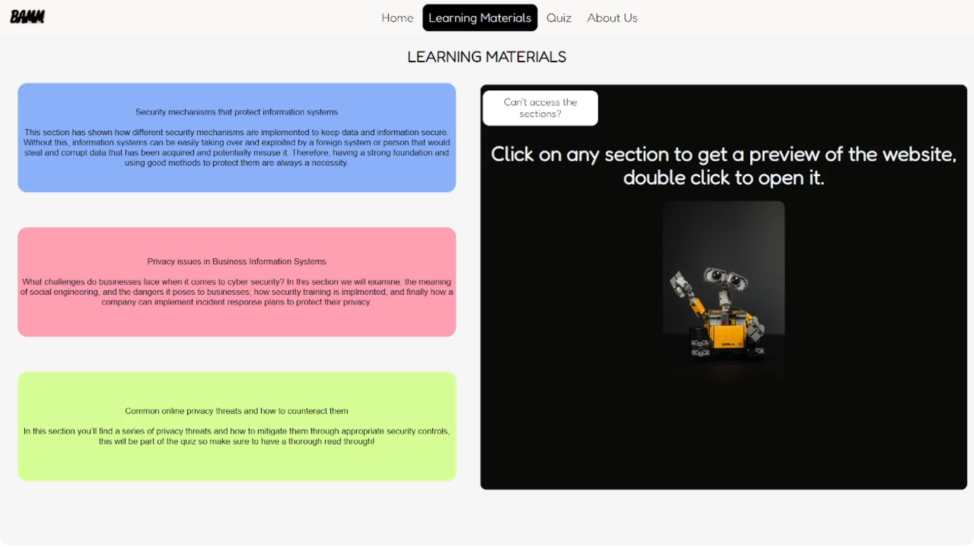
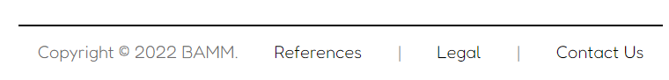

Slide 15
Legal & ethical considerations
Talk about the legal website
Talk about MIT licence (open sourced it)
Talk about the accessibility options we added

Slide 16
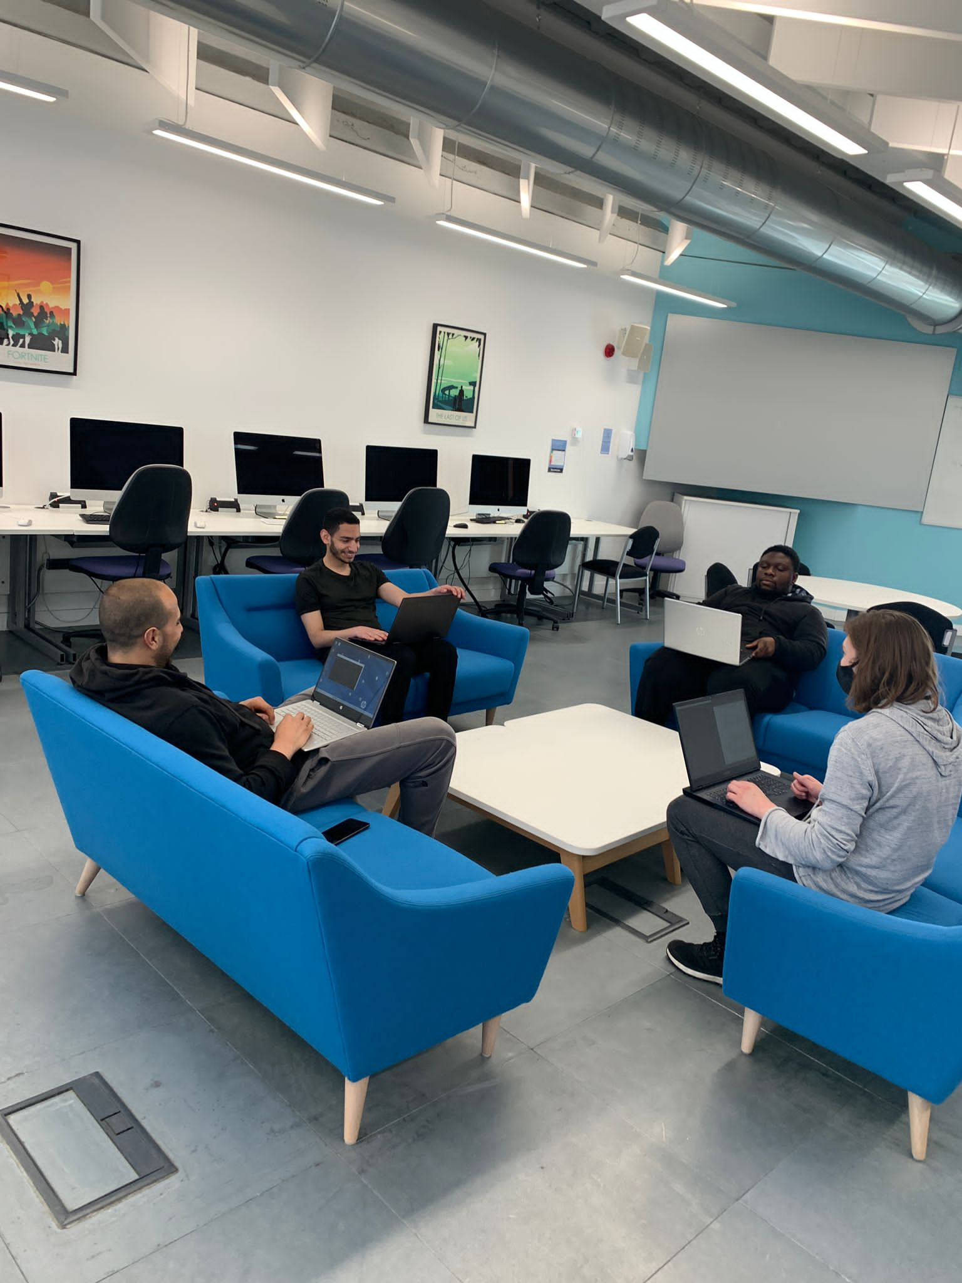
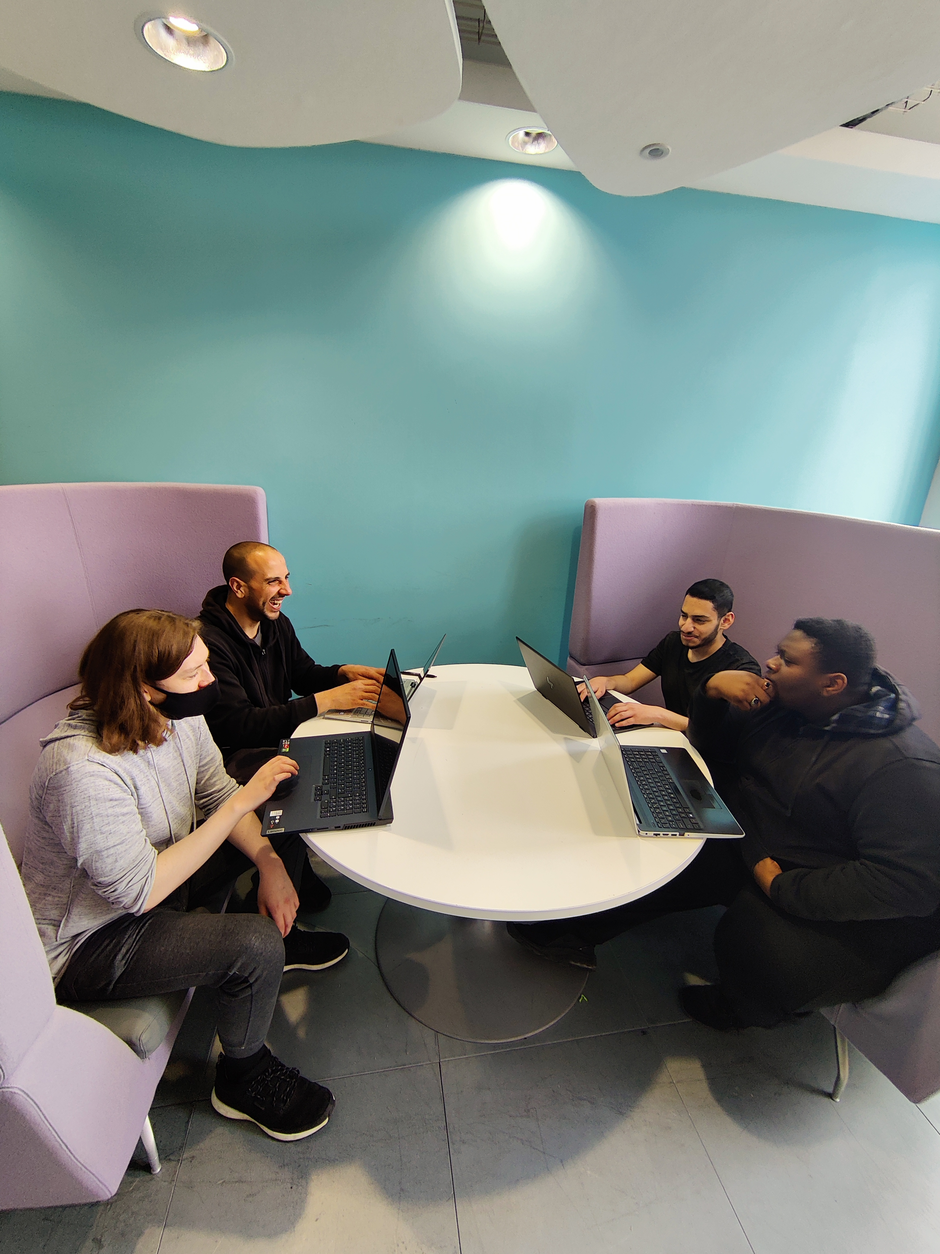
What we learned…

Slide 17

Any Questions

Slide 18

Thank you
BAMM
https://mf600.brighton.domains/CI453/

